Slide 1

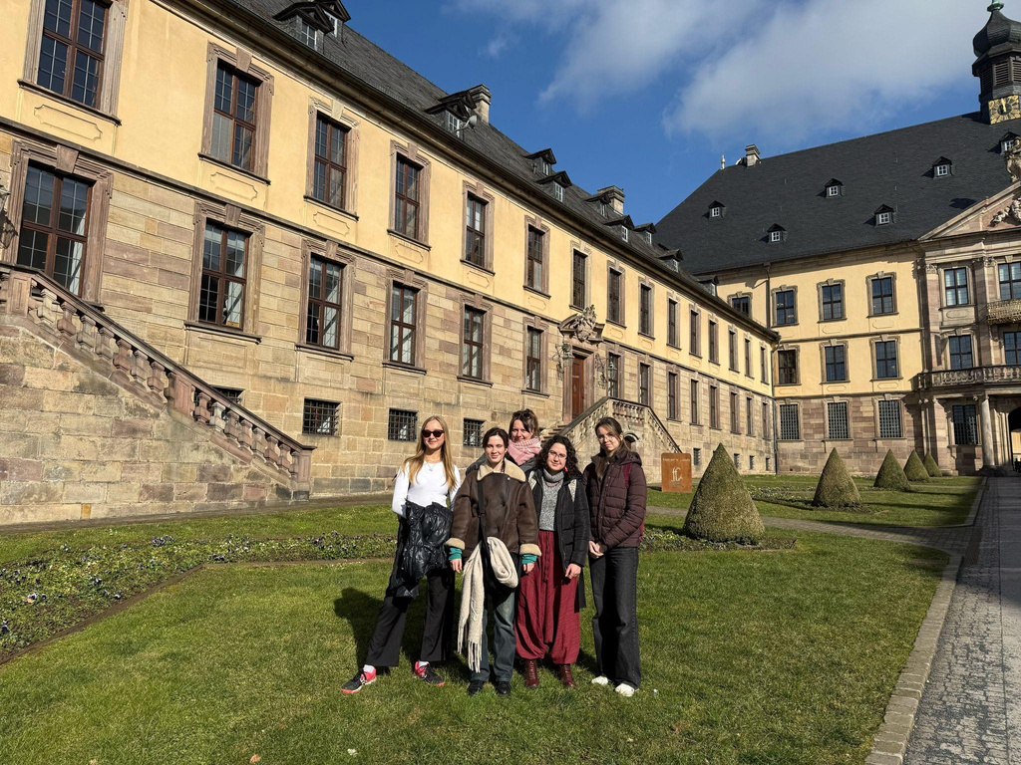
SHORT-TERM MOBILITY - ERASMUS+
OUR ADVENTURE IN GERMANY
STELA AND ANEŽKA

Slide 2
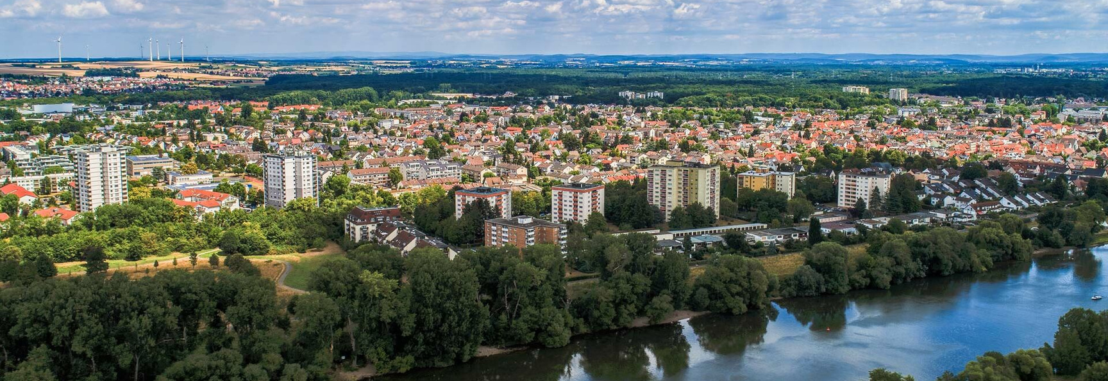

Short-term mobility
Maintal, Hesse
hotel Irmchen
18th – 28th Feb. 2025
WHAT, WHERE, WHEN?

Slide 3

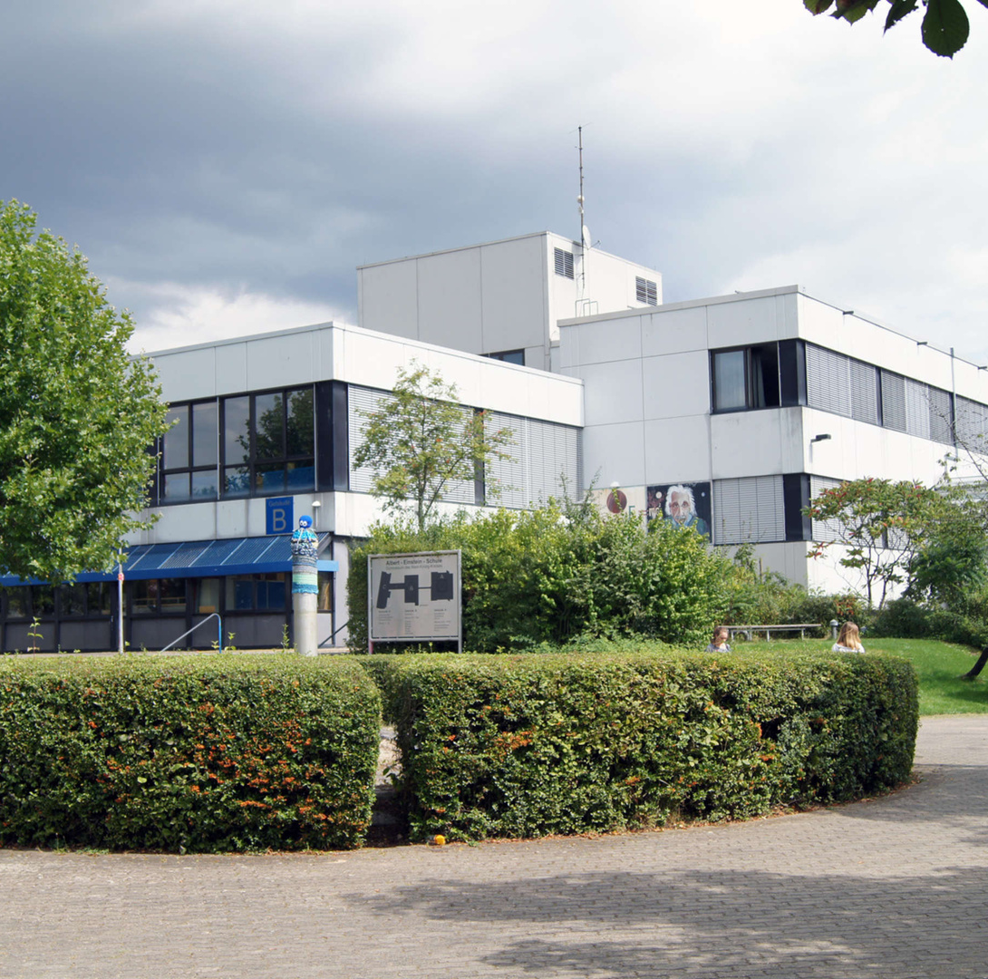
SCHOOL
Albert Einstein Gymnasium
1,500 students; 100 teachers
Daily block teaching
School buses

Slide 4
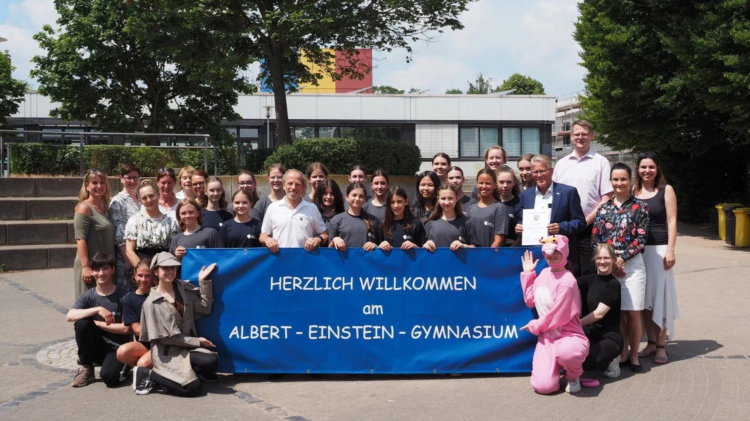
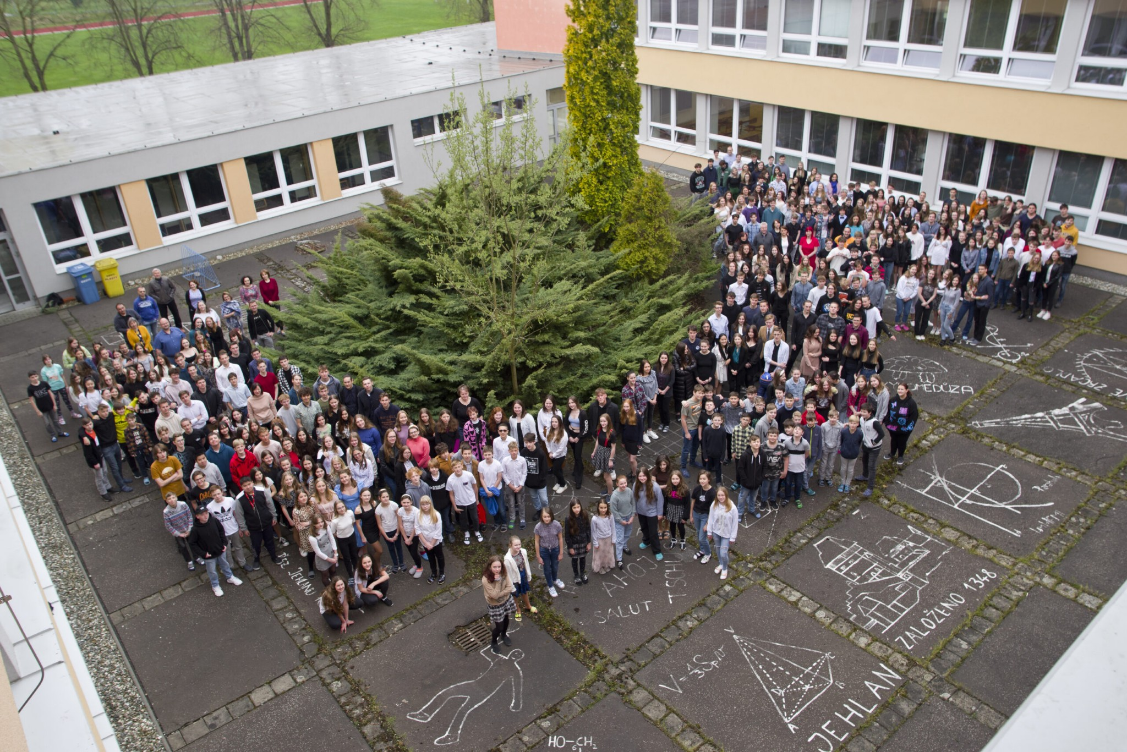
COMPARISON
MAINTAL VS OUR ALMA MATER
Larger capacity
Different subjects (e. g. Politics, …)
Block teaching
No fixed classes, just year groups
Special rules

Slide 5
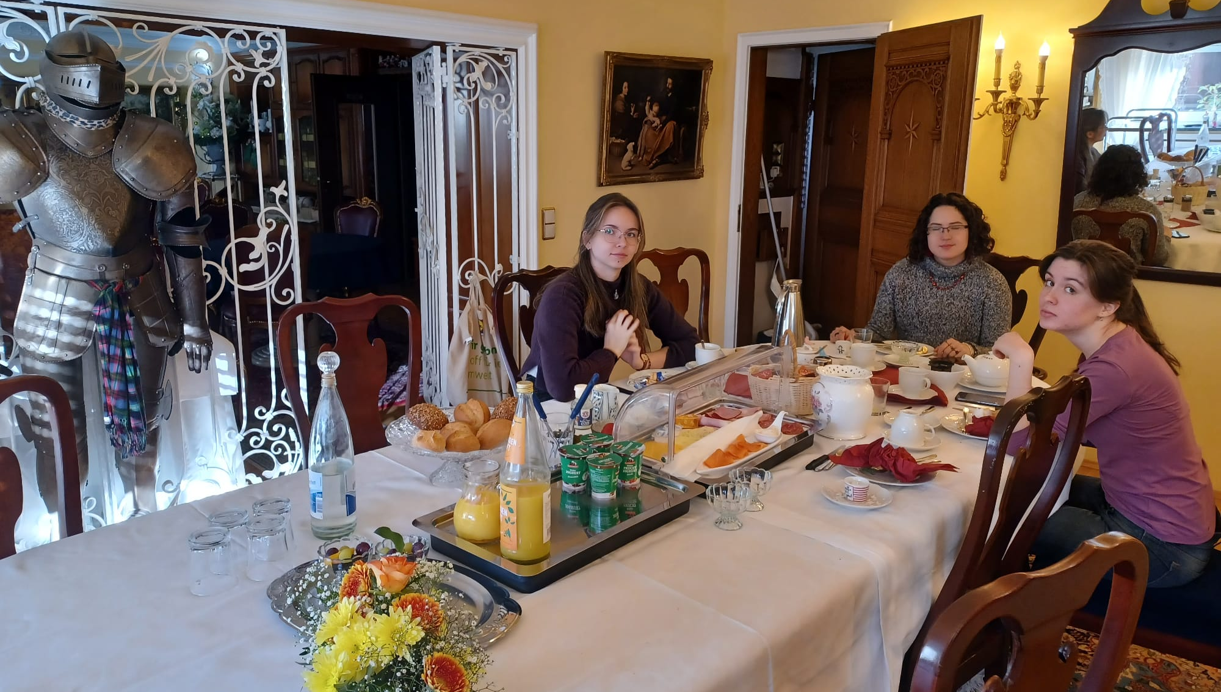
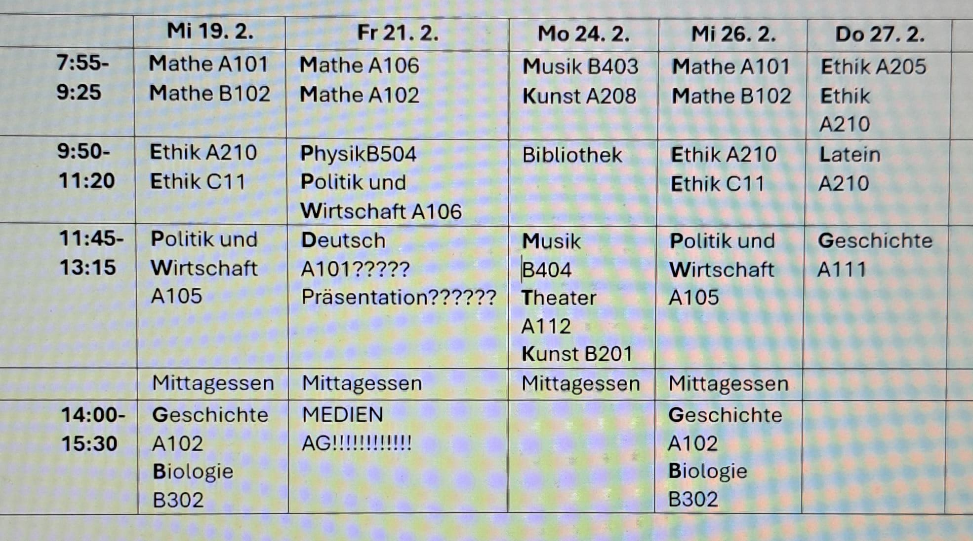
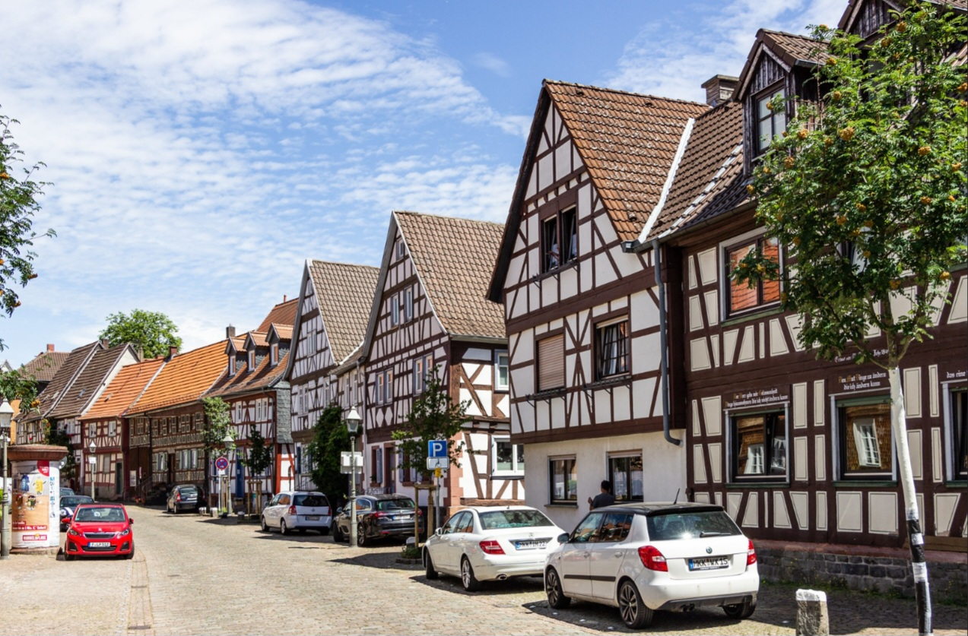
OUR ORDINARY DAY
Excellent breakfast at the hotel
School from 7:55 to 15:30
Sports, shopping, free time, ...

Slide 6
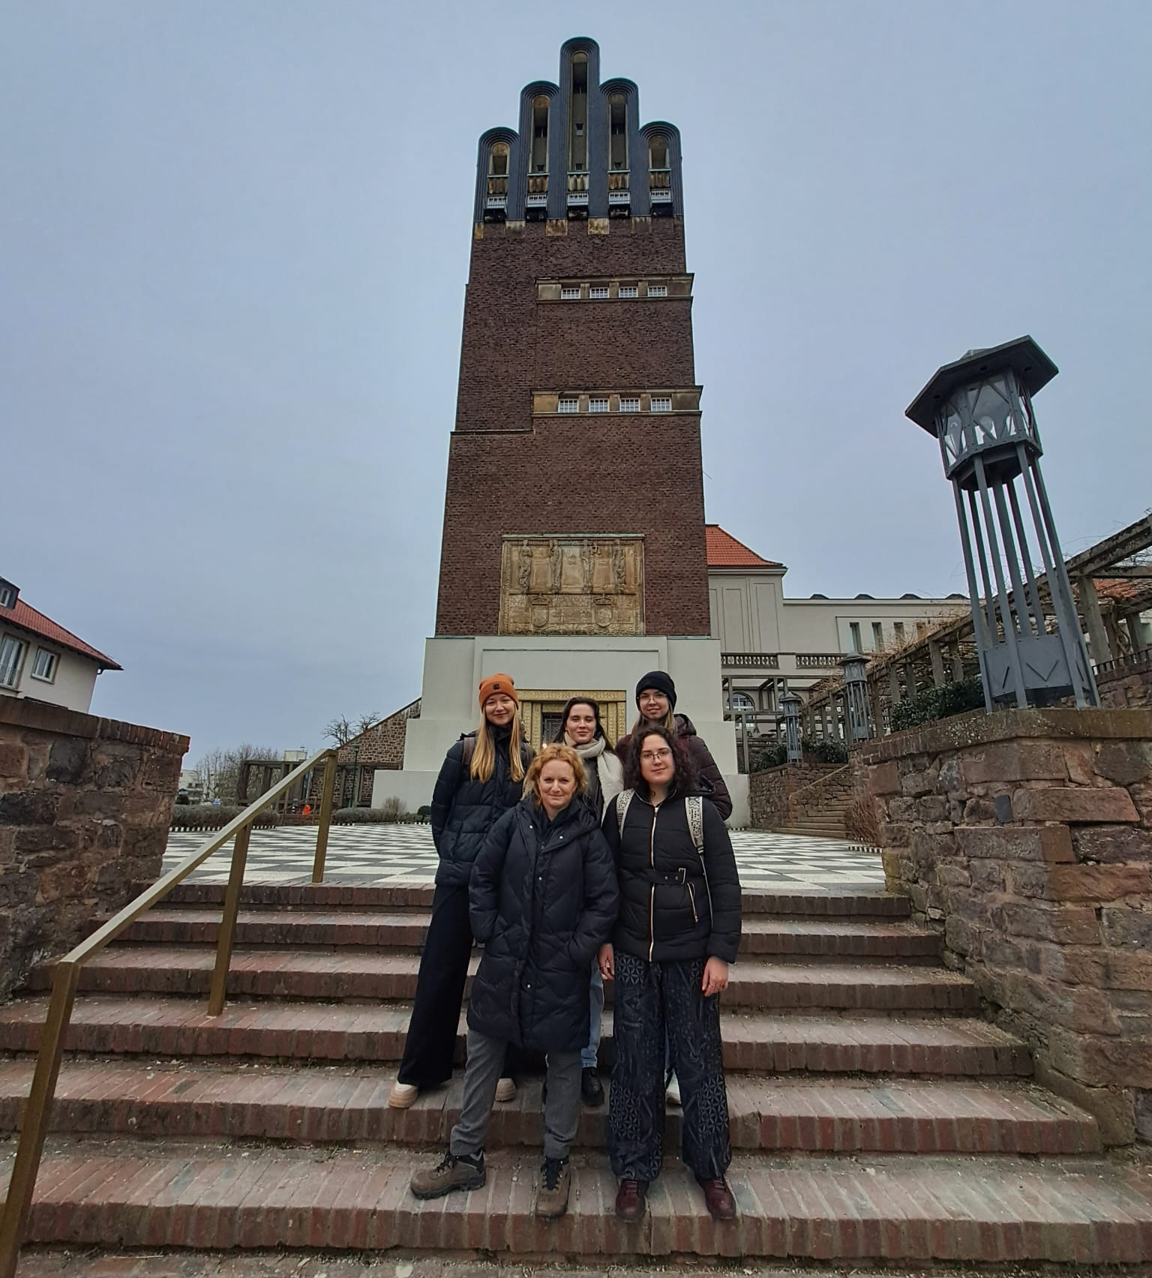
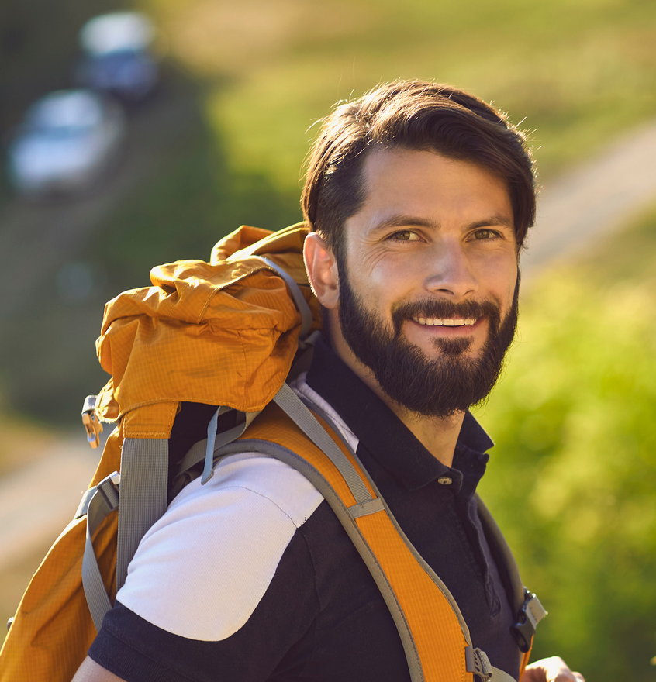
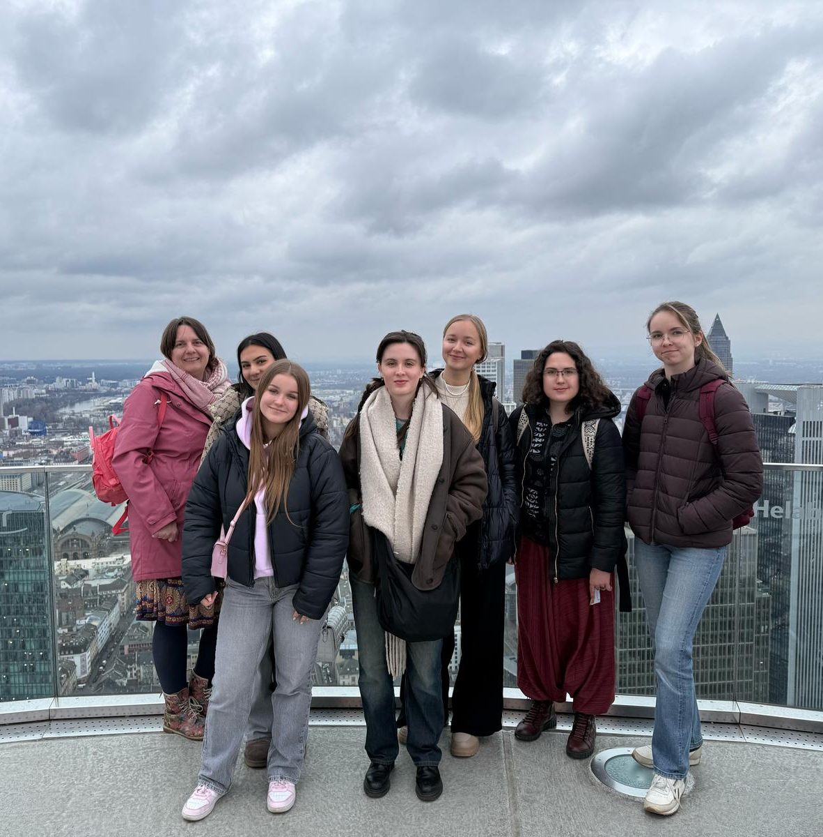
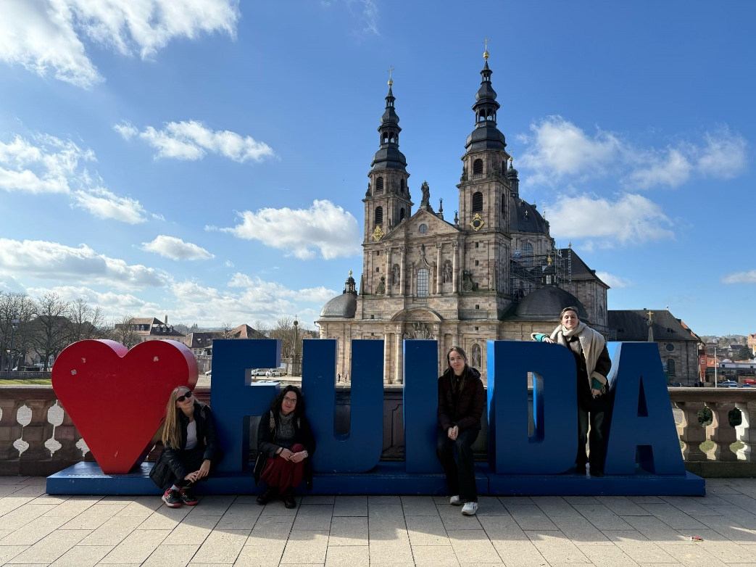
TRIPS
Darmstadt
Fulda
Frankfurt
Technology and students
Peace and history
Big city

Slide 7

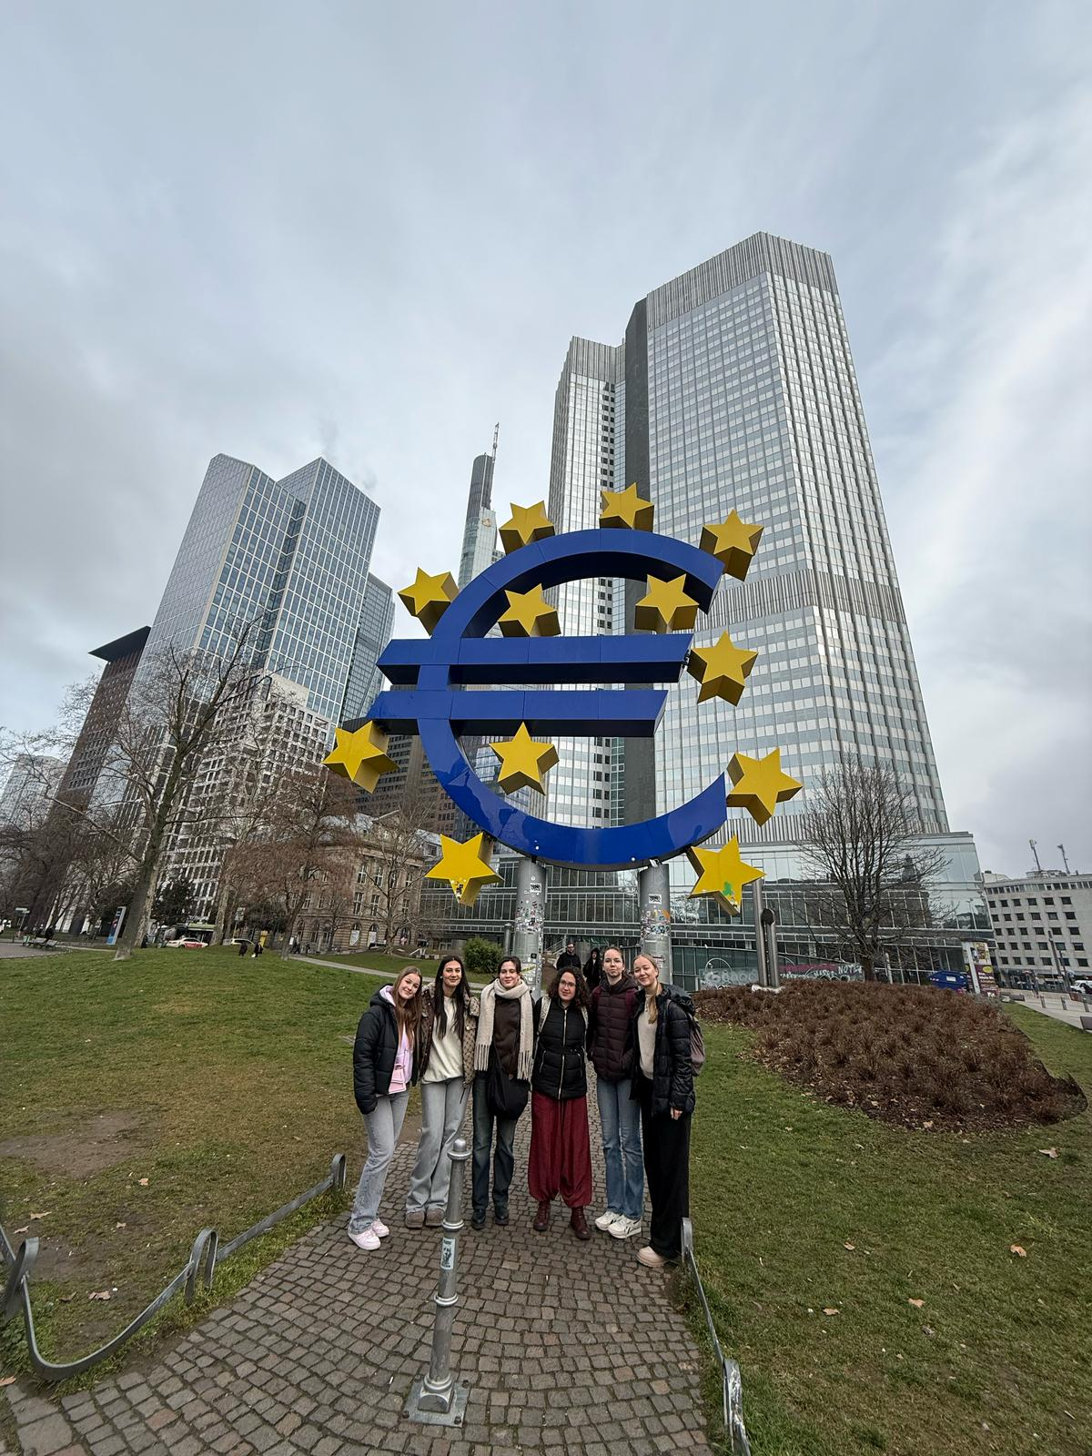
WHO CAN PARTICIPATE?
Anyone interested in going abroad
Good grades are an advantage, but not a requirement
Understanding is not a problem☺

Slide 8
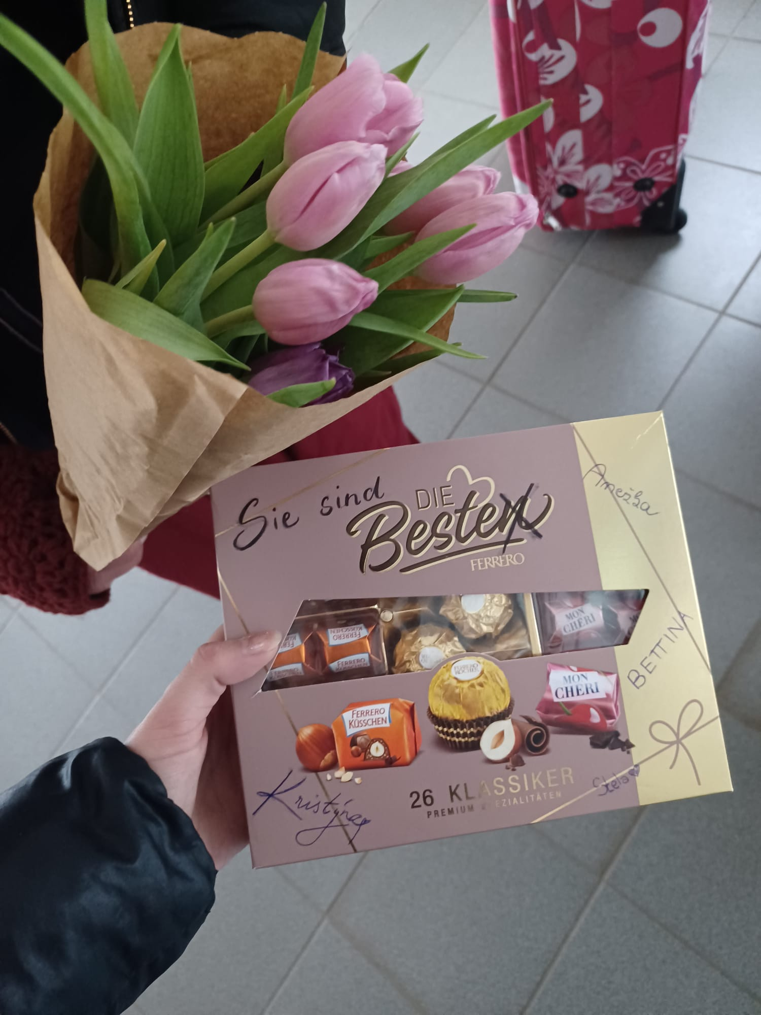
GOOD LUCK AND
THANK YOU FOR YOUR ATTENTION

